Slide 1
Music video analysis

Slide 2
This is America – childish gambino

Slide 3
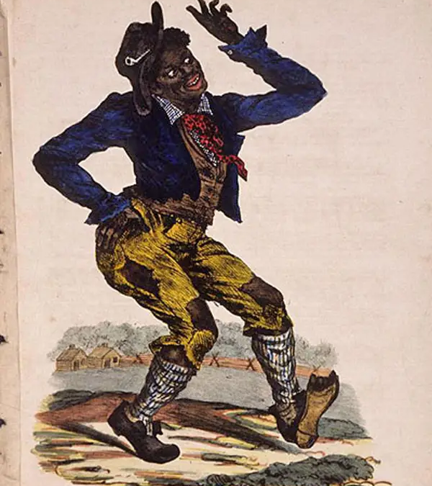
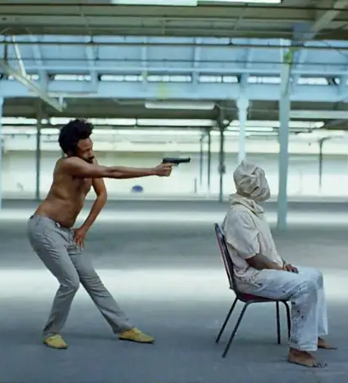
Man shot in head
As soon as the man is shot in the head the tone of the music changes at the same time from happy to aggressive
It could suggest that black people are oppressed by the government and that the man is innocent and is not doing anything wrong apart from playing a guitar but is still shot and he is later dragged away to almost act like nothing ever happened
Furthermore, the pose that Donald Glover is in resembles an illustration of a character named Jim Crow, the fictional character that perceived African people as "lazy, stupid, and inherently less human."

Slide 4
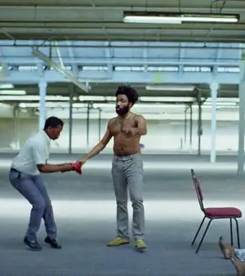
Handing over of gun
It shows that America cares more about Firearms being treated with care however black bodies don't get the same treatment as an object that has no life.

Slide 5
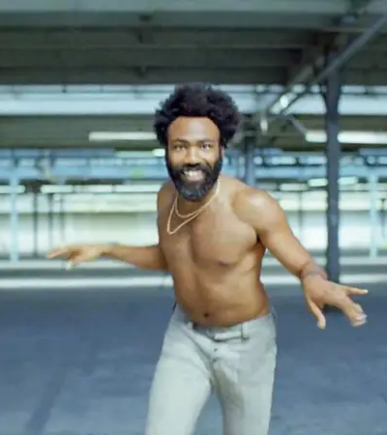
Outfit
Donald is shirtless for a specific reason and that is too show us and remind us he is black and is exposed to the same problems he is trying to raise awareness for
The clothes he uses also have been carefully picked as the style of trouser confederate soldiers wore to remind the violence they brought on people of African heritage.

Slide 6
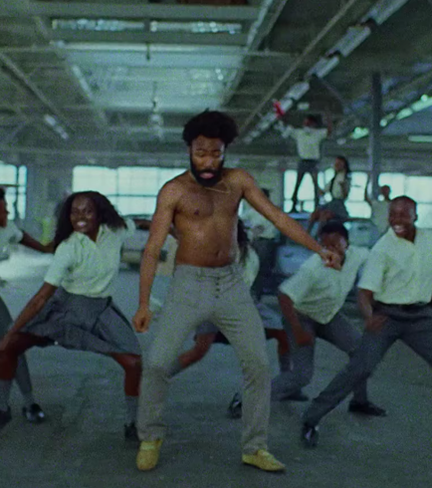
Gun violence
The kid in the background shows a young kid shooting a money gun however this could be for a variety of reasons.
Firstly, it could show how young kids are exposed to weapon violence and how corrupt America is
Secondly, it could reference all the cases where kids have died to the police due to there ethnicity.

Slide 7
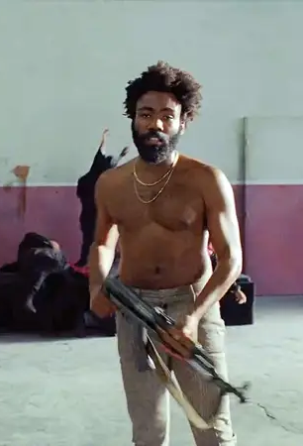
Choir shooting
Glover goes out a door and shoots a church choir with an assault rifle. It could be a reference the killing of nine people of an African-American ethnicity at a church by a white supremacist named Dylann Roof in Charleston, South Carolina, in 2015
The assault rifle he is holding is an AK-47 which was created to kill mass amount of people in wars and shooters tend to use this gun in shootings in the US

Slide 8
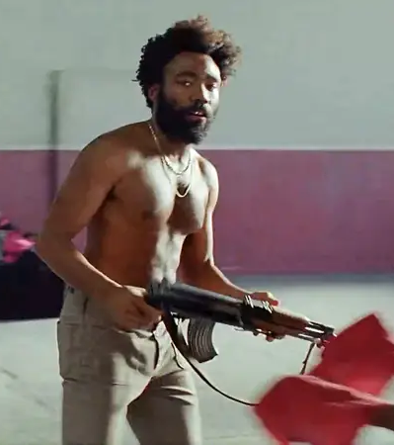
Gun and red cloth
Again the gun is claimed with care suggesting that guns have more value and need to be looked after more than black bodies

Slide 9
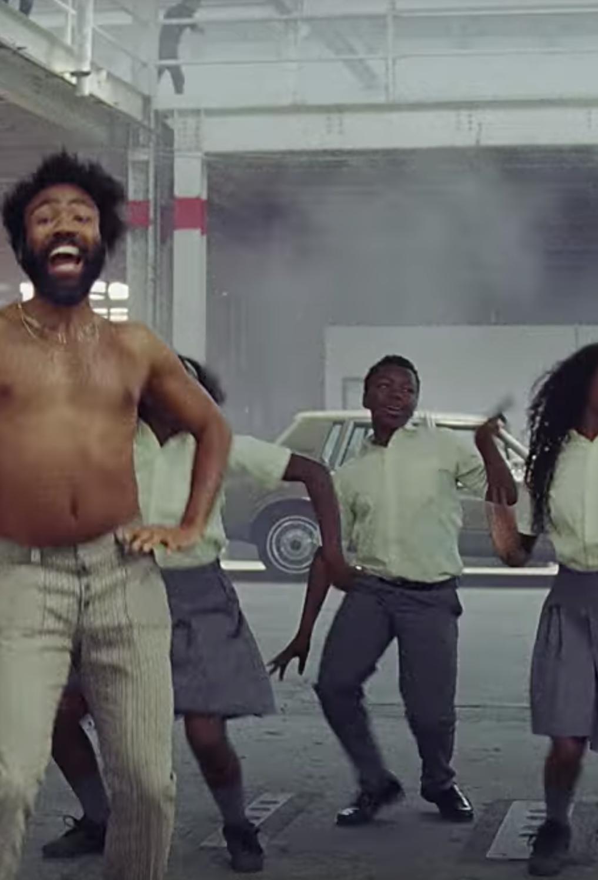
Man committing suicide
On the balcony above Glovers head a man is seen to jumping off of a balcony committing suicide. They seem so happy and are dancing with smiles this could be a nod to American media and how it commercializes black people even thought death is actually happening behind the scenes

Slide 10
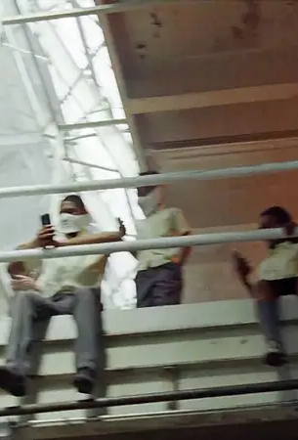
Young boy on phone
It could nod to the tragic shooting of Stephon Clark who was shot and killed by police even though he was unarmed and on his phone.

Slide 11
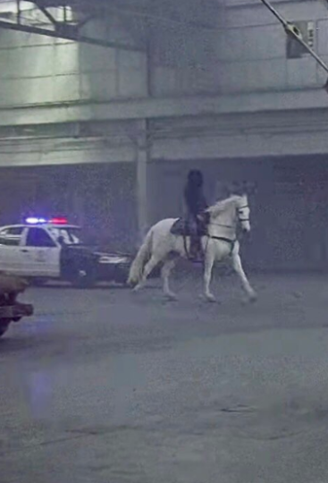
police
Glover is pictured to be dancing with the school kids with a police car and a horse shortly behind
The person on the horse could be Death itself and this shows how police and death are shortly behind Glovers life. It also shows how black people are oppressed in todays society.
It also shows the relationship of the US Police departments and Death.

Slide 12
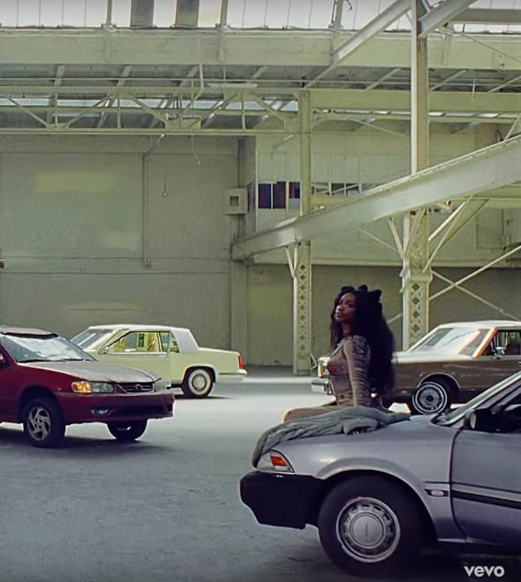
Cars
The cars Glover is standing on are all pulled over with there doors open
This could be a reference to how black people are forced to pull over and get out of their vehicle even though they are doing no harm

Slide 13
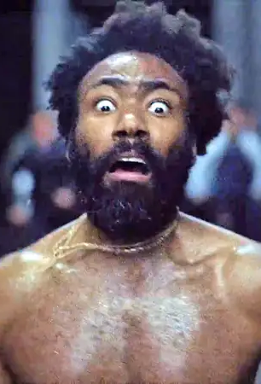
Glover running
Glover is seen to be smoking and then is proceeded to be chased by white police officers
He said that police care more about black men using drugs than gun violence
Furthermore, this shows the suppression of black people by the police

