Slide 1
Directors pitch
Candidate Name: Rahaul Karavadra

Slide 2
Mise en scene

Slide 3
costumes
My artists costumes are based on a modern day, fashionable person this is because R.A.N.C.H believes as a society certain groups are left out and by creating this sense of fashion it will stand out and he will be easily recognised.
The other side actors will wear bland clothing as it will show they conform to society today and this will really make R.A.N.C.H stand out in the video

Slide 4

CHARACTER COSTUMES
Parents
Both will show cracked masks to show they are still conforming to social norms.
Dad – Suit to show he is educated
Mum – Suit aswell
Boyfriend
Similar clothes to R.A.N.C.H to show they are different
Boyfriends Parents
Dad – Smart shirt and trousers
Mum – Dress
They will wear masks as they are exactly the same as everyone else.
Male Side Characters
T shirt, Dark coloured trousers and basic shoes
Mask to show everyone is the same and that R.A.N.C.H is an outsider
Female Side Characters
Mask to show everyone is the same and that R.A.N.C.H is an outsider
Plain Dark T shirt, Dark coloured trousers or skirt and basic shoes

Slide 5
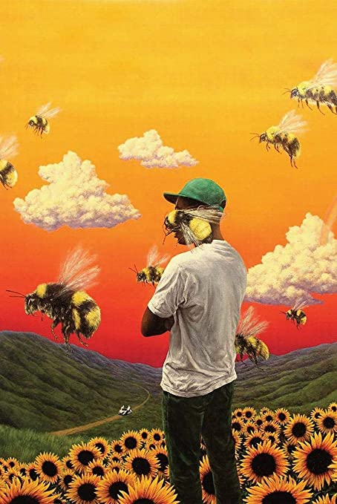
props
Bedroom
Bed - when the video starts to show the song is starting at a new day, also when R.A.N.C.H is falling it will be on his bed as he is going to sleep
Vinyl Player - to introduce music and to also show it’s a new story/chapter
Poster of Tyler the Creator (focuses on similar beliefs) – Intertextual reference
Naruto Headband
Clothes on floor - throughout the video to show life is getting messier by the day
Curtains – Will be closed later on to show life is getting darker for R.A.N.C.H
Love letter saying “Sorry” – At the end of the video a note will be shown to suggest R.A.N.C.H has committed suicide and with it being in the bedroom it will suggest that he started there and ended there.

Slide 6

props
Streets
Shops
To show location
US flag as the song is talking about how Miserable America is behind the curtains

Slide 7

props
Boyfriends House
Table
Food – Big dinner
Chairs
Cutlery
Utensils
Picture of family
Rough example of Boyfriends House

Slide 8
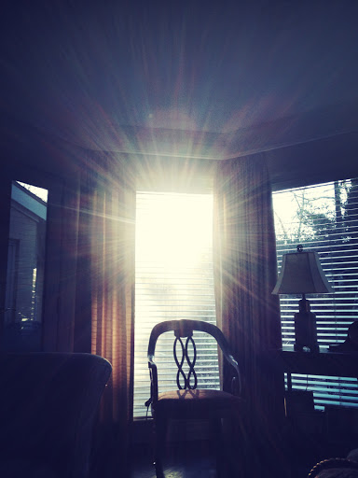
Lighting
The chosen lighting throughout the video will be progressive I have done this to suggest that as the events unfold his life is getting darker so the light will also fade away with R.A.N.C.H.
The lighting will start of high key to show that R.A.N.C.H is okay as he has not come out yet and none of the problems have started and that life is good.
Towards the middle the lighting will become less as his life is starting to take a turn however there will be some glimpses of light to suggest that is the hope which is the boyfriend keeping him alive.
At the end the lighting will be near to none with the curtains being closed suggesting that when the boyfriend is taken away R.A.N.C.H has no hope left which leads to his passing.

Slide 9

sound
A few diegetic sounds will be used throughout the video this is because it will engage the viewer and make it feel more personal as it makes them think and feel as if they were in the room themselves.
When R.A.N.C.H stands up to turn on the music player all audio will play as the music has not started. Furthermore, the sound for the vinyl static will be enhanced as it is telling the viewer to be ready as the story is starting.
At the end a video will be played of R.A.N.C.H laughing with him laughing over the track to make it seem more personal as it is like a memory of when R.A.N.C.H was once happy.

Slide 10
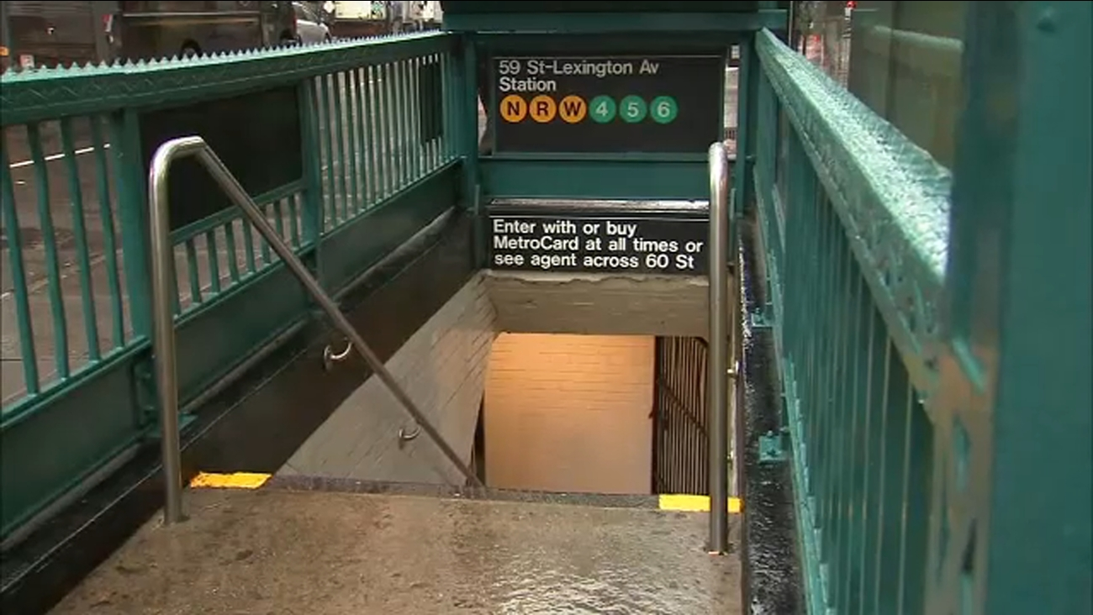
Locations
The locations used will be listed below
New York subway station
Home Kitchen – ( when R.A.N.C.H comes out to his parents)
Friends Kitchen – ( for boyfriend )
Home Bedroom
These locations will back up the bio song and its meaning as it is based in America

Slide 11
Narrative/plot

Slide 12
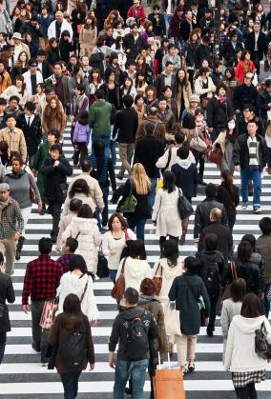
concept/plot
The concept idea is a reference to the BLM and LGBTQ movement using the song Miserable America by Kevin Abstract. This is a good song to use it supports my message and idea of inequality of in the world. The lyrics of Miserable America support the idea that I want to portray in R.A.N.C.H’s music video
The plot will be focused around a young boy who feels different to what society expects as he has been holding in that he is in fact gay and has feelings for other men. It shows he is in a relationship with another man and they are both struggling to deal with how society deal with it. It starts off with his parents disowning him as a son due to this decision of coming out and later the boyfriend and his parents leave the city as they think no one will see them the same and they are embarrassed because of the boyfriend's decision. The overall meaning of the story is to show how minorities feel today and to show how hard it is to come out. It will also focus on racism as there is still a lot of racism in the world today. This song perfectly represents the struggles R.A.N.C.H feels as he grew up.

Slide 13
Characters

Slide 14
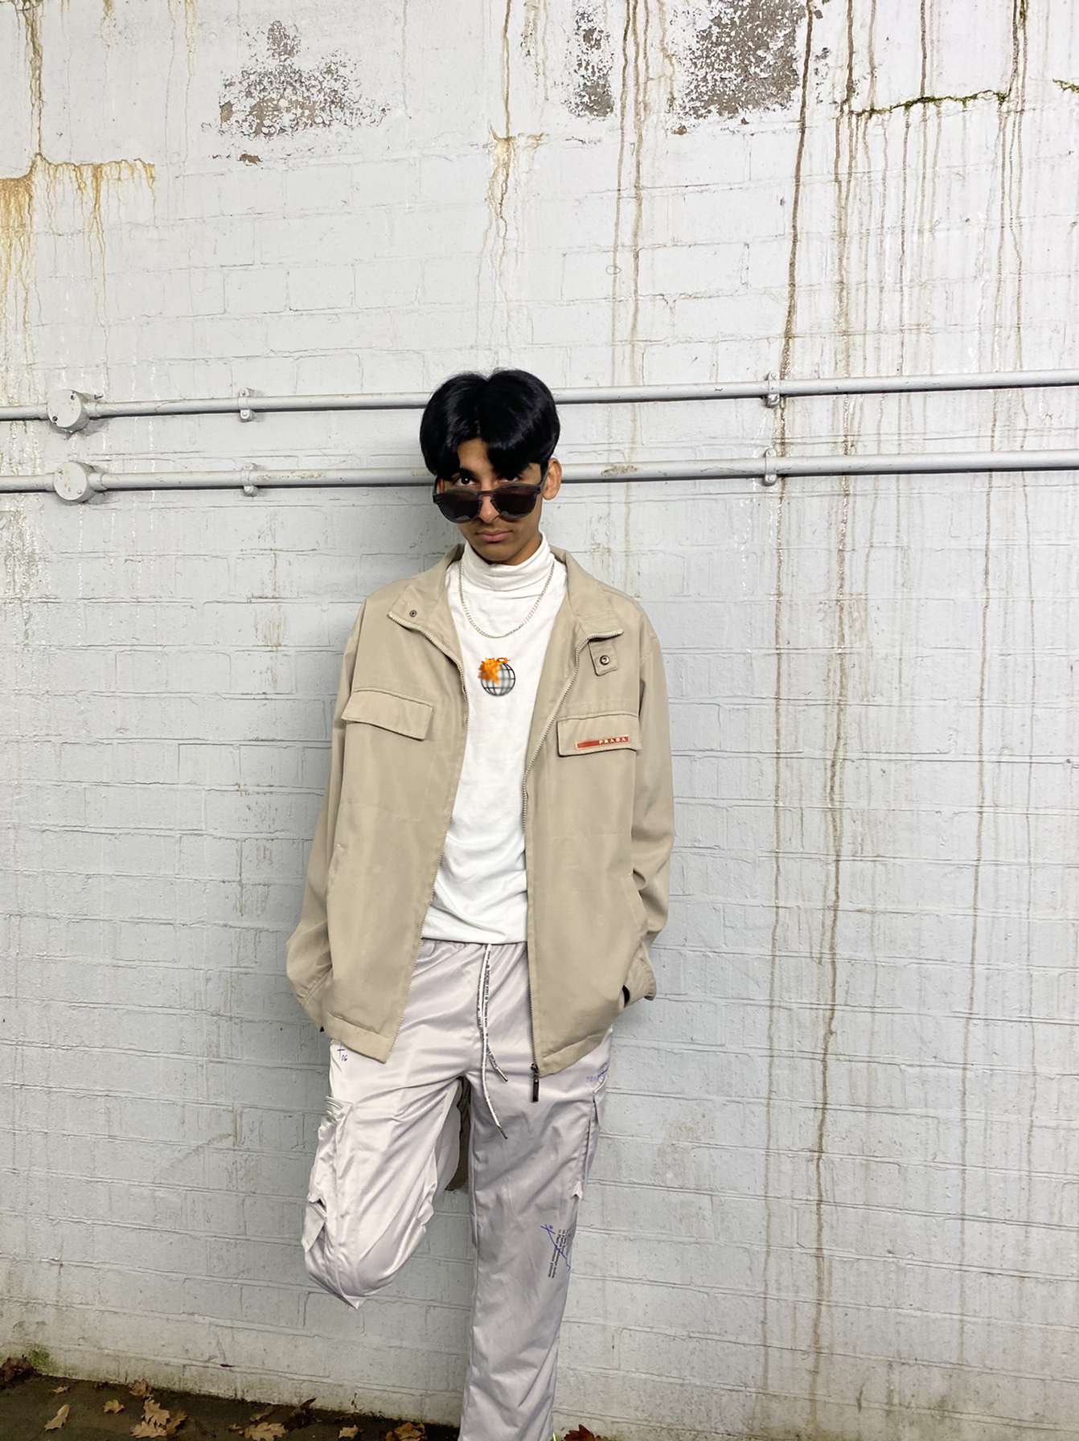
Main characters
R.A.N.C.H (Artist)
R.A.N.C.H has been used to challenge the stereotypes and social groups that should operate in todays society. Due to R.A.N.C.H being homosexual and an ethnic minority in the video this challenges the patriarchal straight white men filled society as of today.
R.A.N.C.H’s boyfriend
R.A.N.C.H’s boyfriend is there to show that one is not alone when it comes to these things and that there are people who will support you no matter what society thinks. He also challenges todays society and flips it on its head as his parents do support him but are too weak as they fear society will look down on them leading to them moving eventually.

Slide 15
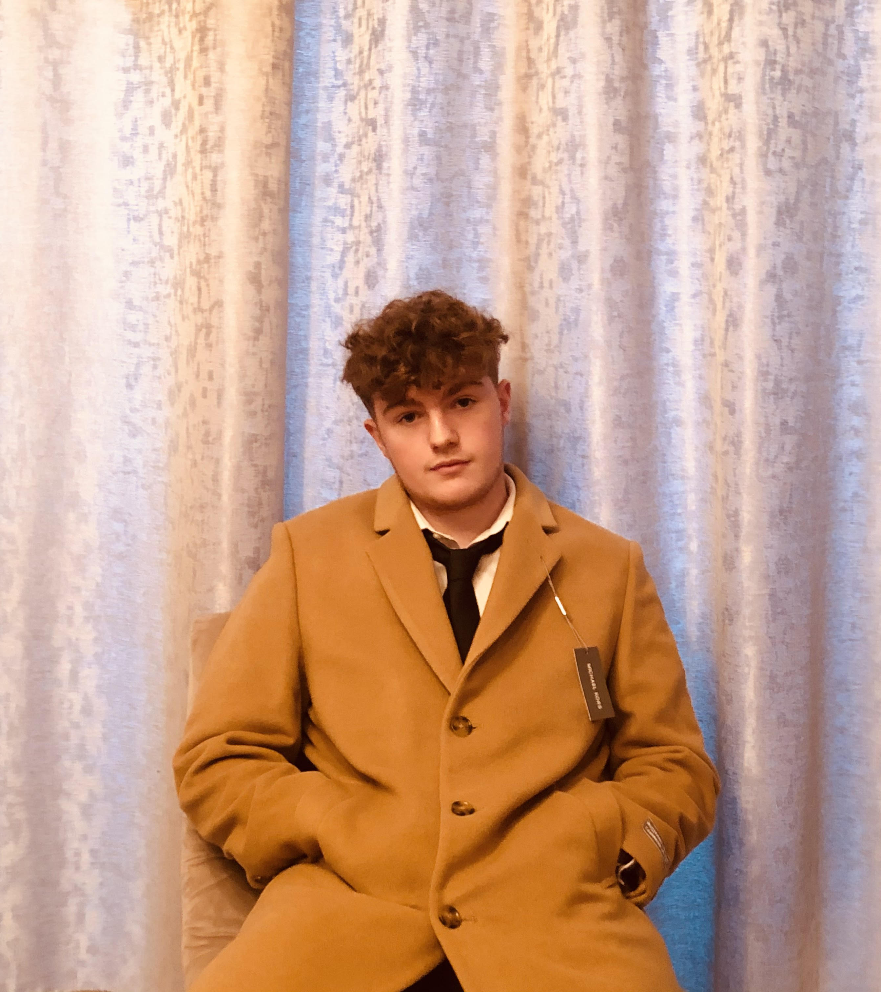
Side characters
R.A.N.C.H’s Parents
R.A.N.C.H’s parents would be a place holder to show how kids can experience horrific events like this even at the comfort of their own homes and shows a traditional old school parent type who will not accept their own blood just for the person they love
Boyfriends Parents
The Boyfriends parents are there to show that even if a family is close they can be weak minded and conform to what society wants. In this case the family don’t want other people to know their son is homosexual and therefore move away so they the son does not have contact with R.A.N.C.H and the boyfriend stays silent and accepts this outcome leaving R.A.N.C.H in the dust

Slide 16
Intertextual references

Slide 17
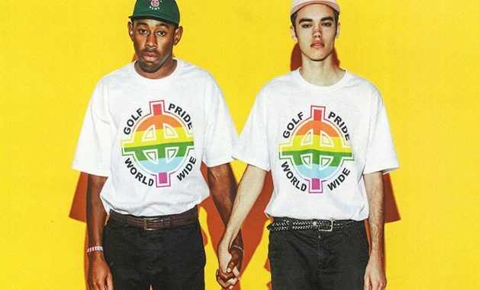
Tyler the creator
A poster is shown to reference the artist Tyler The Creator and his album ‘Flower Boy’ in which he shares similar beliefs and views
Not only this Tyler is in the same genre for music and share similar music with R.A.N.C.H
He has proved to be popular among the younger population who now see him as a role model
He came out to the public in the track ‘I aint got time’ in which he says ‘I have been kissing white boys since 2004’

Slide 18
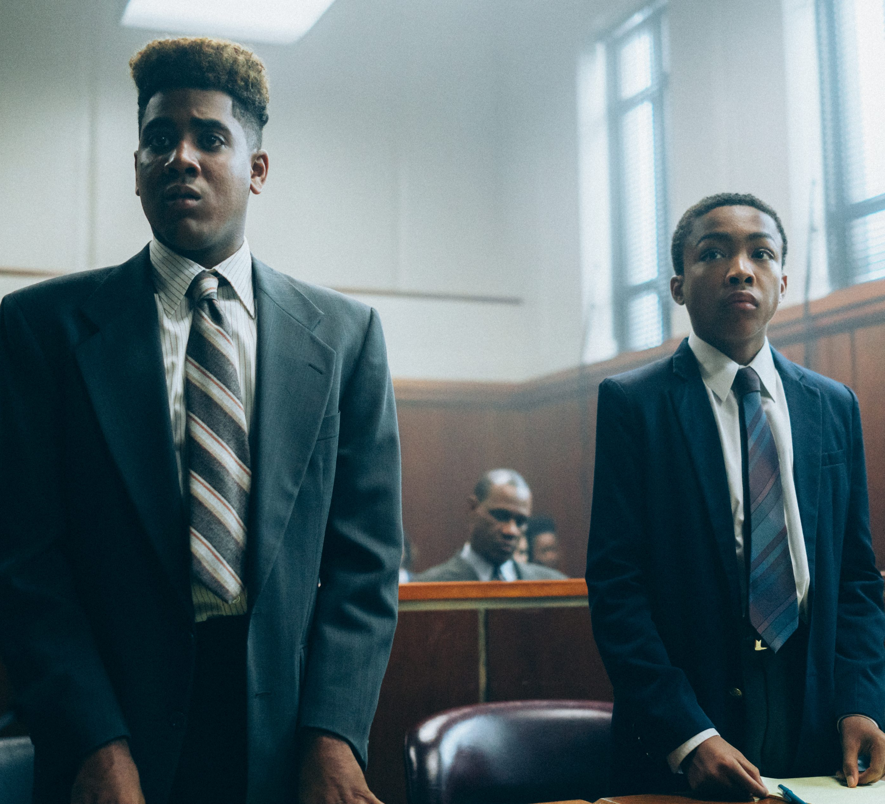
When they see us
“When they see us” talks about the story of 5 innocent men who were accused of brutally attacking a pedestrian. The show shows the court case and how the men were treated unequally in this scenario. I will use mise en scene by having 5 men sat in chairs with a man in a suit shouting at them as R.A.N.C.H walks past them

Slide 19

naruto
When R.A.N.C.H is in his room a Naruto headband appears next to the vinyl on the desk
R.A.N.C.H has always been a fan of anime and loves to incorporate references throughout his videos
Naruto is a Japanese anime created in 2007
It focuses on a young boy named Naruto who is casted out for having a spirit of a beast who wrecked the local village earlier on in life.
R.A.N.C.H feels that including a reference to this shows how kids are cast out just for being different and this fits with this song perfectly.

Slide 20
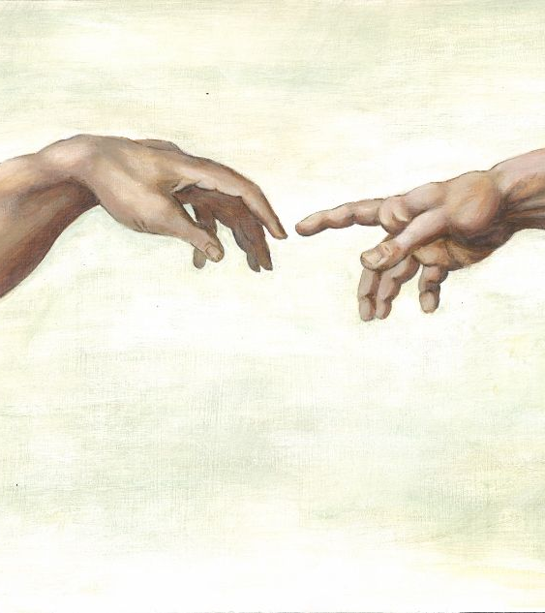
Creation of adam
This intertextual reference has been used to show the parting of R.A.N.C.H and his boyfriend
It has two meanings. Firstly, it is meant to suggest that R.A.N.C.H doesn’t want his boyfriend to leave and that he is being left by himself and shows the parting of the two boys.
Secondly, the meaning behind this painting is to show when God created Adam to make the human population with Eve. However, this shot shows that the boyfriend was God and that R.A.N.C.H is Adam and that the boyfriend created R.A.N.C.H and gives him an objective in life and once his boyfriend leaves R.A.N.C.H feels he has no objective in his life leading to his passing.

Slide 21
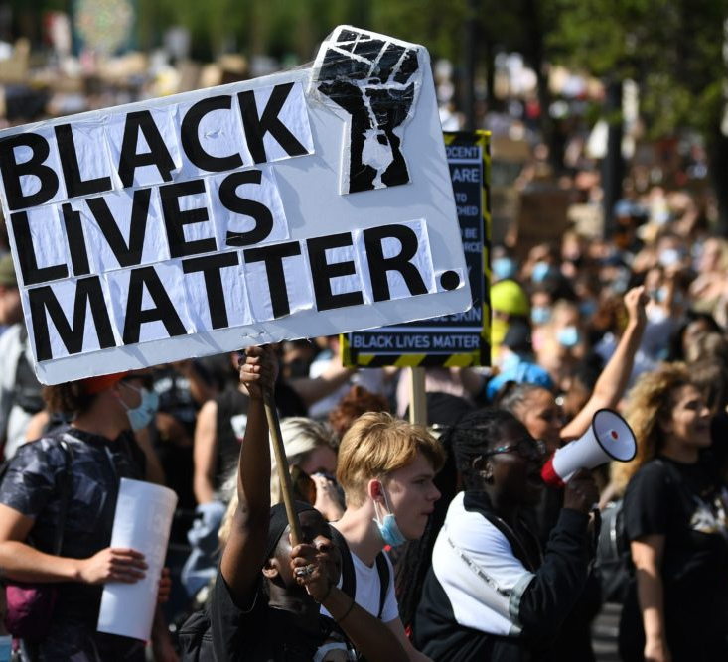
Historical events
In the scene where R.A.N.C.H is falling it zooms into his eyes and once in the pupil it transitions to all that the previous generations have gone through and this is a way of paying respects to show where we all have come from.

